Slide 1
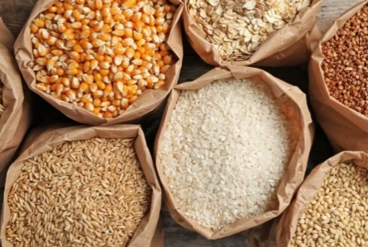
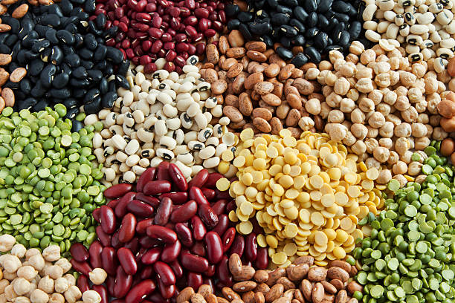
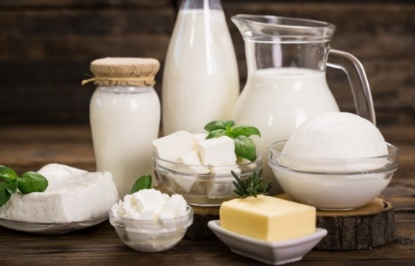
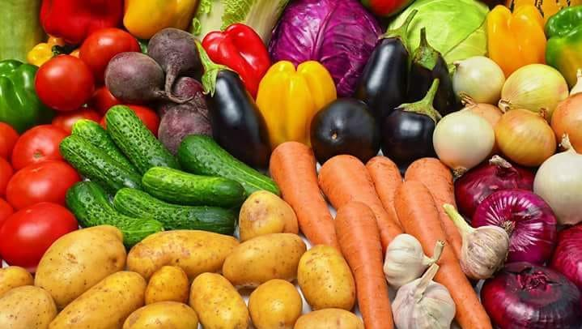
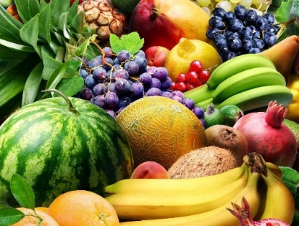
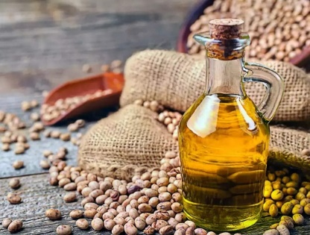
Introduction to ICCOA
& an Overview of its Projects
www.iccoa.org
Manoj Kumar Menon
Executive Director

Slide 2
What is ICCOA!
01
VISION
02
MISSION
03
ORGANIC ADOPTION
& CERTIFICATION
A KNOWLEDGE AND LEARNING CENTRE FOR ALL FACETS OF ORGANIC AGRICULTURE WHILE WORKING AS AN INTERFACE ORGANIZATION FOR THE ORGANIC MOVEMENT
A TRULY REPRESENTATIVE ORGANIZATION FOR THE ORGANIC MOVEMENT IN INDIA.
BUILD COMPETENCE OF INDIVIDUALS & ORGANIZATIONS IN ORGANIC AGRICULTURE
BUILDING ECOLOGICALLY, ECONOMICALLY & SOCIALLY SUSTAINABLE AGRI-SYSTEMS & BUSINESSES
32,218 Ha – PGS
(PKVY/ NAMAMI GANGE/SRLM)
81,588 Ha – TPC
(MOVCDNER/MIDH/NEC)
CSR
04
POLICY ADVOCACY
05
CAPACITY
BUILDING
06
KNOWLEDGE & NETWORKING
STATE ORGANIC POLICY -UTTARAKHAND, KARNATAKA, HP, SIKKIM , AP, TN
MINISTRY OF RURAL DEVELOPMENT
FSSAI
UN-FAO-UNCTAD-IFOAM (GOMA PROJECT)
FARMERS & FPOs
ENTREPRENEURS & STARTUPS
INDUSTRY
STATE GOVTS
INTERNATIONAL PROGRAMS
STAKEHOLDERS Organization (>150 members)
PUBLICATIONS (INCL DIRECTORY)
ORGANIC PACKAGE OF PRACTICES
IFOAM GERMANY, SOUTH KOREA
FiBL, SWITZERLAND; OTA, USA; FAO, ITALY
07
FPOs/FPCs
08
MARKET
DEVELOPMENT
09
INCUBATION
SFAC
NABARD
NAFED
NCDC
NDDB
State Agencies
TRADE FAIRS – National, International
BUYER SELLER MEETS
REGIONAL/STATE TRADE FAIRS
MARKET RESEARCH
INTERNATIONAL MISSSIONS
JAIVIK VIGYAN KENDRA – TRAINING CENTRE
SUS AGRI – PVT COMPANY
JAP – FARMERS PRODUCER COMPANY

Slide 3
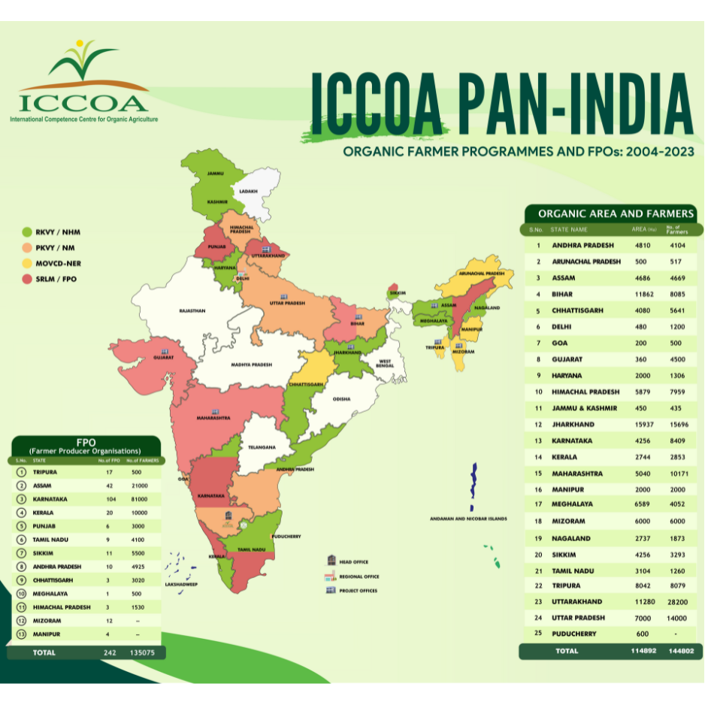
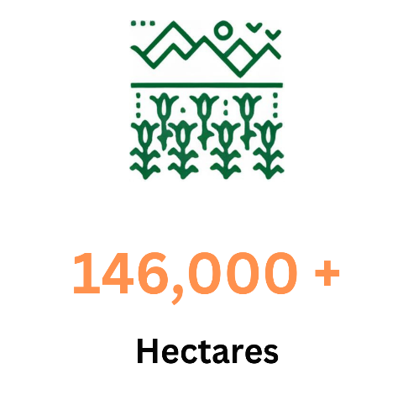
What is ICCOA!
ICCOA is a not-for-profit ‘knowledge & learning center’ promoting organic agriculture & agribusiness. It is also an interface organization for all stakeholders in the sector

Slide 4
ICCOA Collaboration beyond the borders
FiBl, Switzerland
IFOAM Organics International, Germany
Nuremberg Messe, Germany
IFOAM Asia, South Korea
Organic Trade Association, USA
Access Agriculture, Belgium
GIZ, Germany
HELVETAS, Switzerland
Bio Reporter International, Germany

Slide 5
Special Projects of ICCOA
Creation and strengthening of farmer-producing companies
Value chain study & Development
Sustainable bio village development
Market linkages and Market development
Business plan preparation
Research on feasibility of Agroecological practices

Slide 6
Special Projects of ICCOA

Slide 7
Special Projects of ICCOA
Making a business plan for National cooperative for Organics limited, which envisions to turnover one trillion INR by 2035

Slide 8
Special Projects of ICCOA

Slide 9
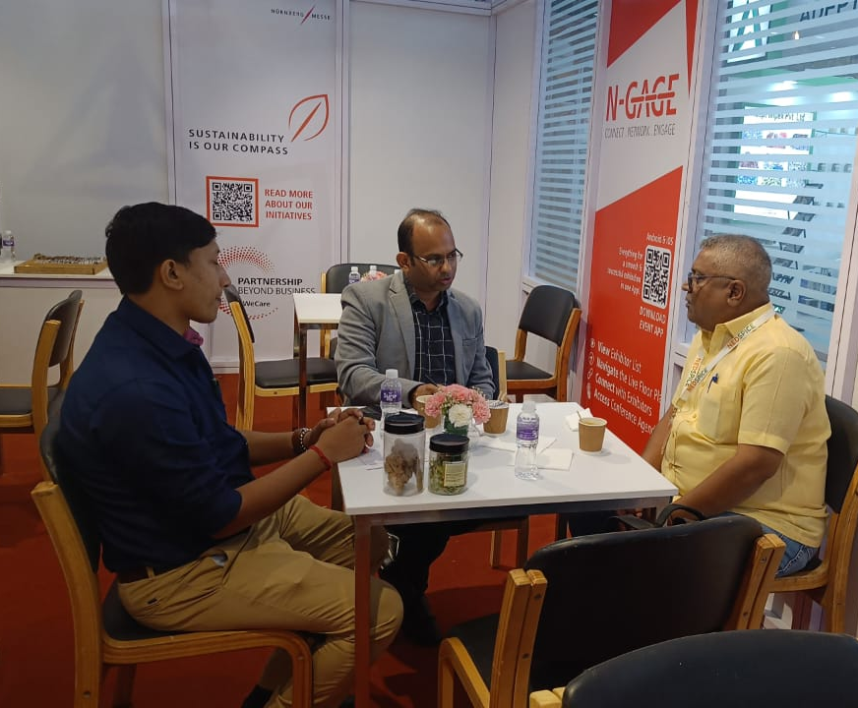
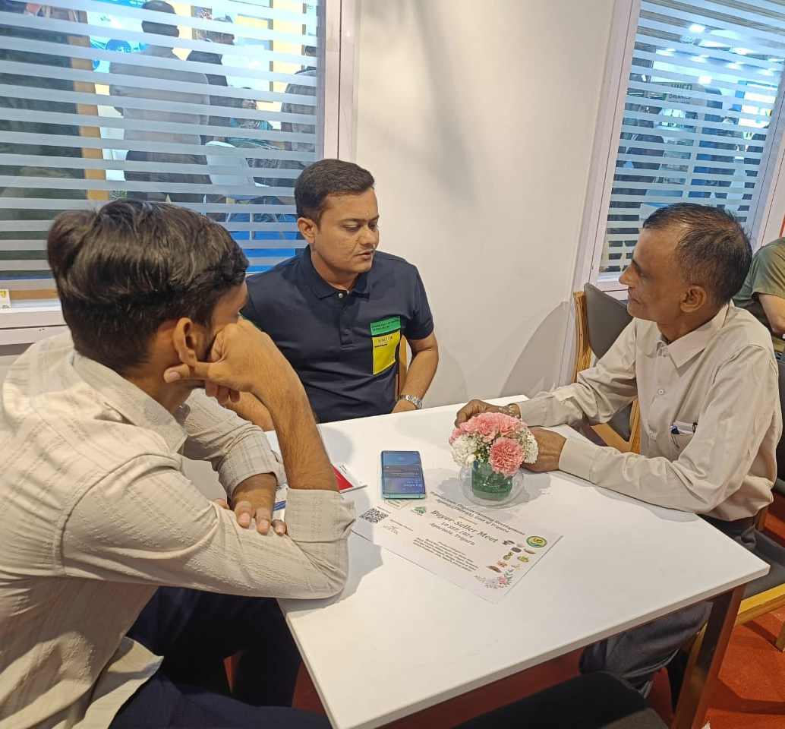
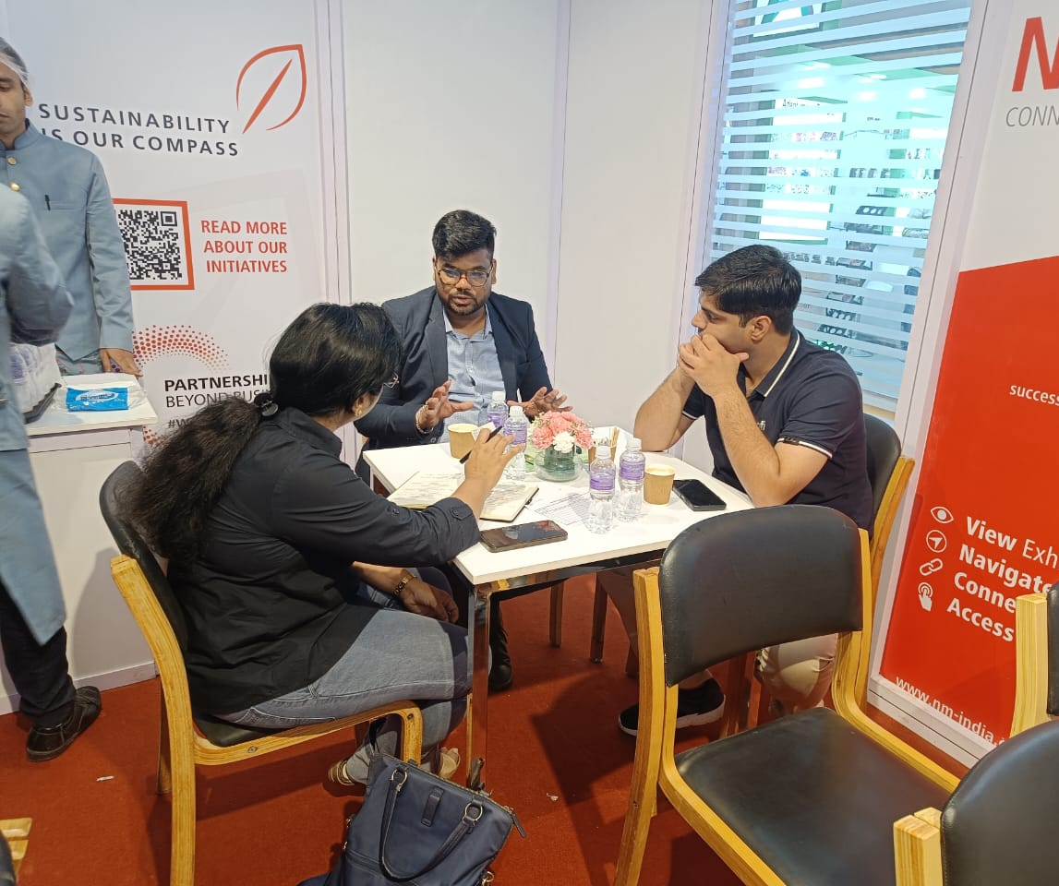
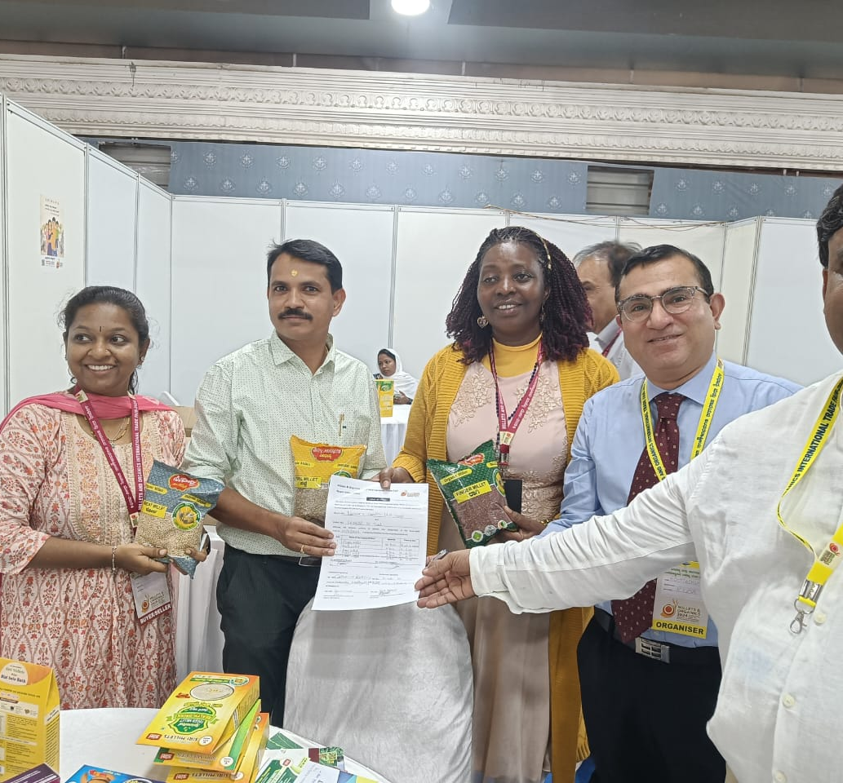
Special Projects of ICCOA
Objective
Creating platforms where Organic & Safe food producers meet real buyers

Slide 10
Special Projects of ICCOA
Established a scalable program of Sustainable Bio-village model across villages with
organic adoption,
certification, and market-linkage,
training, incorporating 07 distinct yet inter-connected components of the Bio-village model
to enhance income by at least 35-40% in 03 years

Slide 11
Special Projects of ICCOA
Collaboration with Nurnberg Messe to conduct Indias biggest Organic trade fair “Biofach India”

Slide 12
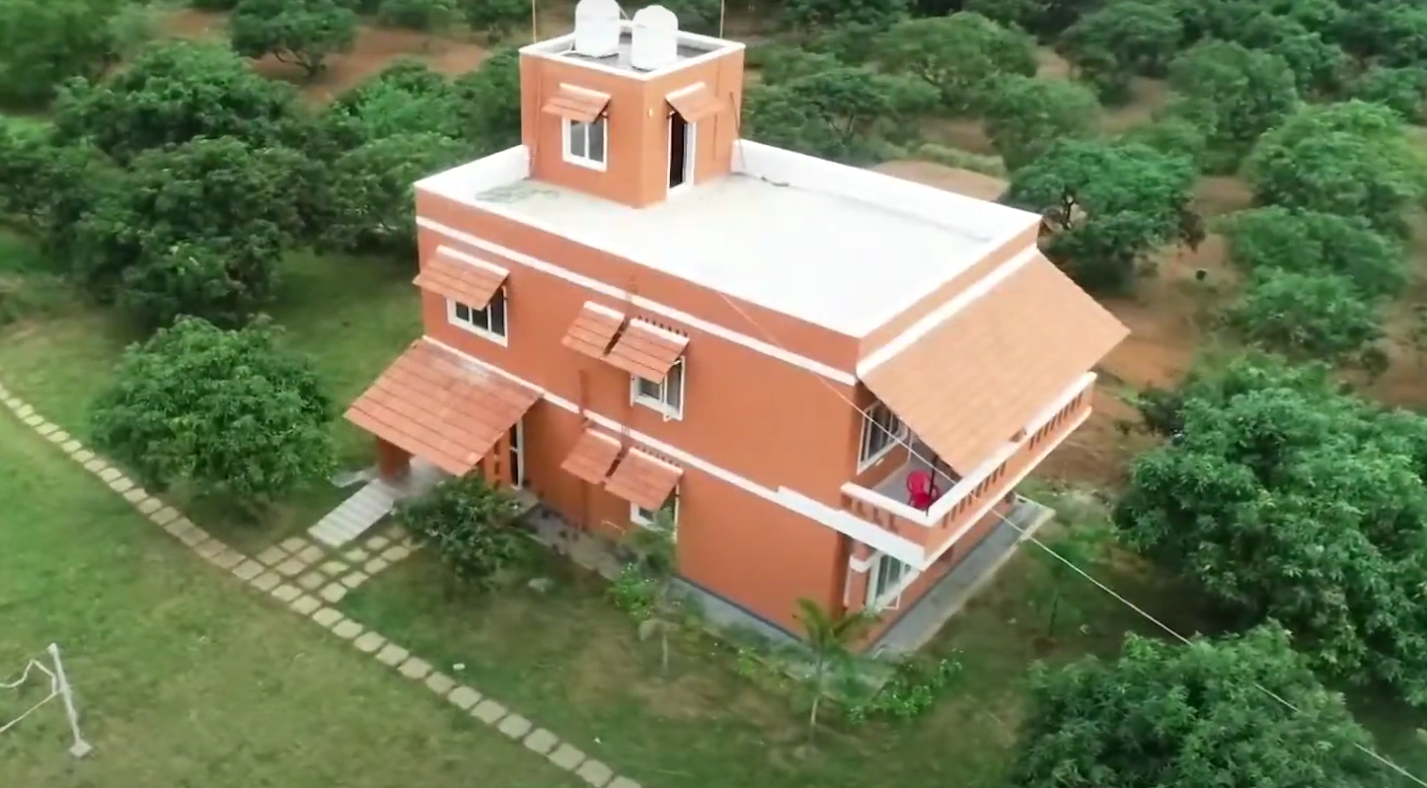
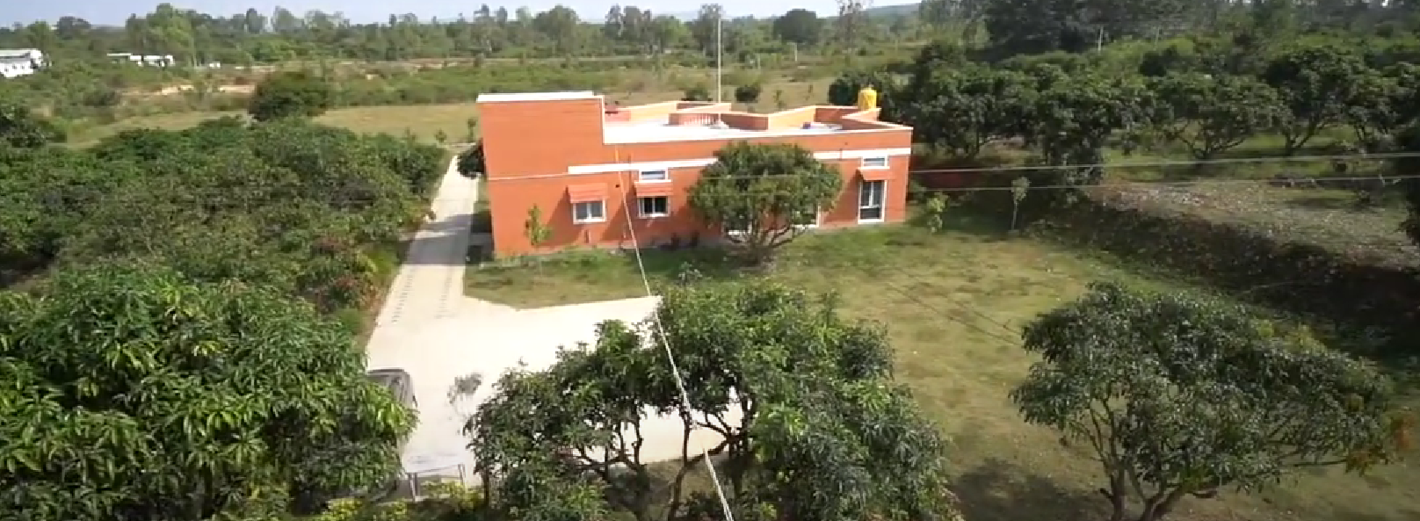
Special Projects of ICCOA
Jaivik Vignan Kendra
https://www.iccoa.org/jvk/

